Slide 1

Bipolar And Sleep Apnea Detection
Presented by
Jagadish s
PES1PG21CA145
Guided by
Dr.Lekha Achuth
Associate Professor

Slide 2
Content
Abstract
Introduction
Problem statement
Proposed solution
Purpose
Project scope
Requirements Analysis
Functional requirements
Non functional requirements

Slide 3
Content
Literature Survey
Technology survey
Future enhancements
Conclusion
biblography
About Tools and Technologies
Hardware Requirements
Software Requirements

Slide 4
Abstract
Mental issue is a main problem everywhere globally bipolar and sleep apnea are some foremost issues. Bipolar and sleep apnea kinds of disorders are separate hospital-based issues that could co-arise in many people and both of which could have a giant effect on human basic fitness and well-being. bipolar disease is grouped by the aid of high temper swings including a series of mania and melancholy whilst sleep apnea is a sleep problem this is indicated by way of recurrent episodes of interrupted respiratory for the duration of sleep. Bipolar and sleep apnea detection helps a person to check whether the person has bipolar or sleep apnea disorder this gives results at earlier stages if the disorder is detected at an earlier stage it can be effectively diagnosed and treated.
.

Slide 5
Introduction
Bipolar disorder, formerly referred to as manic depressive illness, is a mood disorder with two extremes: depressed and manic. It varies in severity, and mild cases may appear ordinary for many years. Symptoms vary; a person may be depressed.
The process of decision-making is made more difficult by the fact that medical information frequently contains information that has been withheld. Discovering previously hidden trends
in medical information and performing data analysis both need the use of computer vision.
There are many methods for making this analysis more efficient, and machine learning
is one of them.
Bipolar illness may be diagnosed and treated more effectively if it is diagnosed and treated
at an earlier stage

Slide 6
Problem Statement
Bipolar disorder, formerly called manic depression, is a mental health condition that causes
extreme mood swings that include emotional highs (mania or hypomania) and lows (depression).
When you become depressed, you may feel sad or hopeless and lose interest or pleasure in most activities. When your mood shifts to mania or hypomania (less extreme than mania), you may feel euphoric, full of energy or unusually irritable. These mood swings can affect sleep, energy, activity, judgment, behavior and the ability to think clearly.
And more severe course of illness including poor insight and denial;increased suicide attempts
and higher levels of symptom severity.

Slide 7
Problem statement:
Sleep apnea is a sleep disorder that occurs when a person's breathing is repeatedly interrupted during sleep. The word "apnea" literally means "without breath." People with sleep apnea may snore loudly and may also experience periods of shallow breathing or pauses in breathing during sleep. This can cause them to wake up frequently throughout the night and may lead to daytime sleepiness. There are three types of sleep apnea: obstructive, central, and complex (also called mixed). Obstructive sleep apnea is the most common type and is caused by a blockage of the airway, usually when the soft tissue in the back of the throat collapses during sleep. Central sleep apnea is caused by a failure of the brain to transmit the proper signals to the muscles that control breathing. Complex sleep apnea syndrome, also known as mixed sleep apnea, is a combination of the other two types. Sleep apnea can be treated with lifestyle changes, such as losing weight, quitting smoking, and sleeping on your side, or with medical devices such as continuous positive airway pressure (CPAP) machines or oral appliances. In severe cases, surgery may be necessary.

Slide 8
Proposed Solution
The objective of this project is to determine the presence or absence of bipolar and sleep apnea in the subject additionally if a patient has type 1 or type 2 bipolar disorder assume that they are likely to enter a bipolar disorder phase based on the medical report the user provided the required input information next the historical data set is loaded because most medical records contain missing information reliable estimation becomes difficult to fill up the gaps interpolation and data cleaning are necessary using an approach that combines data cleansing and computing they must turn unstructured data back into unstructured data when the calculation is complete this approach aims to identify individuals with sleep apnea as early as possible and provide them with appropriate treatment to alleviate symptoms and improve overall health and theyll-being.

Slide 9
Purpose
The objective of this project is to determine the presence or absence of bipolar and sleep apnea in the subject additionally if a patient has type 1 or type 2 bipolar disorder assume that they are likely to enter a bipolar disorder phase based on the medical report the user provided the required input information next the historical data set is loaded because most medical records contain missing information reliable estimation becomes difficult to fill up the gaps interpolation and data cleaning are necessary using an approach that combines data cleansing and computing they must turn unstructured data back into unstructured data when the calculation is complete this approach aims to identify individuals with sleep apnea as early as possible and provide them with appropriate treatment to alleviate symptoms and improve overall health and theyll-being.

Slide 10
Project Scope
The scope of the project is that through information that is provides status of bipolar
disorder, the patient can also see the his/her report through mail or on website. It
would be also a great help for the doctors predict the bipolar disorder at right time.
The Exceptional growth of internet and machine learning technology is witnessed a
wide variety of detecting models and algorithms .

Slide 11
Requirements Analysis

Slide 12
Requirements Analysis
Functional Requirements
.
Doctor Module
The doctor module will build the account and review the data together with the
patient's characteristics to see whether the illness has been impacted.
Patient Module
The patient module asks patients about their symptoms in relation to the ailment
being treated.

Slide 13
Requirements Analysis
Report
The forecast for the final report is going to be provided in report module.
Bipolar Test module
The patient can take the bipolar Test. If the Patient is tested positive for bipolar he is
Send for further treatment.

Slide 14
Requirements Analysis
Non functional Requirements
Reliability
To ensure that it works properly and private information is kept secure,
security data must be provided to the server in a secure manner without changing the
original content of the data
Ease of Use
Due to the user-friendly interface and overall hassle-free navigation.
The reaction of a preprogrammed system is adequate in this case and it can quickly
switch from one mode to another.

Slide 15
Requirements Analysis
Security
User can access only with their username and the password. Thus, protection against misuse of identifiers is provided
Maintenance
The project is updated if it has been previously implemented or
Modified.
Availability
The application should be available 24*7 to the user

Slide 16
Literature Survey

Slide 17
Literature Survey
EXISTING SYSTEM
It is essential to be able to accurately diagnose the patient through physical examination and clinical judgment. Computer-aided decision support systems may be required for reliable choices. Healthcare outcomes are large volumes of data related to patient selection, patient feedback, treatments, follow-up visits, medications and other concerns. You need to put in a lot of planning to achieve your goals. Due to increasing data, legitimate technology is required to collect and process data. It is essential to use the correct disease prediction from the everincreasing medical data. However, processing a lot of data is also crucial.

Slide 18
Literature Survey
Disease Prediction by Machine Learning Over Big Data From Healthcare Communities
Min Chen School of Computer Science and Technology, Huazhong University of Science and Technology, Wuhan, China; Yixue Hao; Kai Hwang; Lu Wang; Lin Wang
With big data growth in biomedical and healthcare communities, accurate analysis of medical data benefits early disease detection, patient care, and community services. However, the analysis accuracy is reduced when the quality of medical data is incomplete. Moreover, different regions exhibit unique characteristics of certain regional diseases, which may weaken the prediction of disease outbreaks. In this paper, we streamline machine learning algorithms for effective prediction of chronic disease outbreak in disease-frequent communities. We experiment the modified prediction models over real-life hospital data collected from central China in 2013-2015
https://ieeexplore.ieee.org/document/7912315

Slide 19
Literature Survey
TERTIARY SYPHIUS PRESENTING AS MANIC DEPRESSIVE PSYCiHOSIS
A. A. PATKAR1, P. V. PRADHAN2, L. P. SHAH8, Y. LOKHANDWALA
With the advent of Penicillin, tertiary manifestations of syphilis have become a rarity,while atypical forms are often encountered. Usually the form of neurosyphilis seen bypsychiatrists is General Paresis of the Insane(GPI) and Taboparesis. Unlike the grandiose forms seen earlier, the cases of GPI today present with a dementic picture (Dewhurst, 1969;
Hahn, 1959). We report a case where Tertiary Syphilis presented initially as Manic
Depressive Psychosis.
https://www.ncbi.nlm.nih.gov/pmc/articles/PMC2992125/pdf/IJPsy-31-261.pdf

Slide 20
Literature Survey
Disease Prediction by Machine Learning
Prasad G. Rao
This review has been done after careful research of articles published in indian journal of psychiatry with the search words of manic depressive psychosis and bipolar mood disorder. Many articles in the following areas are included: 1) Etiology: genetic studies: 2) Etiology – neuro psychological impairment: 3) Adult bipolar disorder 4) Epidemological 5) Clinical picture – phenomenology: 6) Course of bipolar mood disorder: 7) Juvenile onset bipolar affective disorder 8) Secondary mania: 9) Clinical variables and mood disorders: 10) Disability: 11) Comorbidity: 12) Treatment: biological 13) Recent evidence: 14) Pharmacological evidence in special population. Though there seems to be significant contribution, there are still lot of areas which need careful intervention. The findings in various studies from the indian point of view are reviewed.
https://ieeexplore.ieee.org/document/7912315

Slide 21
Literature Survey
DERMATOGLYPHICS IN MANIC-DEPRESSIVE PSYCHOSIS
Hardwar Road
In the present investigation qualitative dermatoglyphic features of MDP patients were studied. 100 adult normal males and 109 normal females of the same ethnic group, formed the control group. Significant differences were noted between normal and MDP, normal and unipolar, normal and bipolar and unipolar and bipolar groups. It was also found .that M.D.P. with positive family history differ significantly from M.D.P. with negative family history on the basis of dermatoglyphic features. It is, therefore, a further indication that manic-depressive psychotics with positive family history are genetically predisposed to the aetiology of M.D.P. The significant differences noted between those with ‘genetic loading’ and those without such history add another dimension in differentiating the two groups. The implications and the areas for further study are discussed.
https://journals.lww.com/indianjpsychiatry/Abstract/1978/20040/DERMATOGLYPHICS_IN_MANIC_DEPRESSIVE_PSYCHOSIS_.18.aspx

Slide 22
Literature Survey
Neuropsychological impairment in bipolar affective disorder
R. Padmavati
Investigations of patients with bipolar affective disorder have demonstrated that although more than 97% of patients appear to recover clinically within 2 years, only 37% recover functionally during the same period.1 Vieta and MartinezAran suggest that residual cognitive dysfunction may contribute to this.2 Several studies using standardized diagnostic criteria and research designs have demonstrated neuropsychological impairment in patients with bipolar disorder in the euthymic phase.3 The presence of subclinical psychopathology in the euthymic phase could partially account for the observed residual deficits.
https://www.ncbi.nlm.nih.gov/pmc/articles/PMC2918318/

Slide 23
Literature Survey
Global atlas on cardiovascular disease prevention and control / edited by: Shanthi Mendis
Published by the World Health Organization
Mendis, Shanthi, Puska, Pekka, Norrving, B, World Health Organization, World Heart Federation.
et al. (‎2011)‎. Global atlas on cardiovascular disease prevention and control / edited by: Shanthi Mendis ... [‎et al.]‎. World Health Organization
https://apps.who.int/iris/handle/10665/44701

Slide 24
Technology survey

Slide 25
Technology survey
Django
Python-based The Django Software Foundation (DSF) is the
organization responsible for the development and maintenance of the open-source
and free web framework known as Django (Django Software Foundation). Django's
rich built-in functionality is largely responsible for its current widespread adoption.
Many popular companies and apps like Google, Instagram, Discus, Spottily, You
Tube and Pinterest use Django to build websites. Python is commonly used in web
development. By placing all HTML files in the "Templates" directory, you can
quickly render HTML pages as templates and static files are supported. Similarly, all
style related files including CSS and JS are stored in the 'fixed' directory. More
customization and flexibility is possible due to this feature. The tasks on the front
end of this project are done using Django. Additionally, Django has more
functionality than competing frameworks, some of which are described below

Slide 26
Technology survey
HTML 5
The process of creating websites and web pages uses a type of markup language
called HTML, known as Hyper Text Markup Language (HTML). In the design of
websites and online pages, Cascading Style Sheets (CSS) are employed. For
validation purposes, JavaScript is utilised instead of CSS, which is used to style
webpages with fonts, colours, and movement. JavaScript is also used for input
validation.
A website's home page can be viewed through any web browser that can download
an HTML file from a web server. It uses Hypertext Markup Language (HTML)
markup. Web pages are designed using a tag-based language.HTML, a markup language, can be used to define the structure of a web page.HTML components, which act as building blocks for HTML pages, are used to create HTML pages.
In HTML scripts, objects are represented using tags.
Some examples of HTML tags are header, design, table and form tags

Slide 27
Technology survey
CSS 3
With CSS, it is possible to design websites in a way that is simple and easy to
understand in terms of complexity. CSS, which is an acronym for "Cascading Style
Sheets", is used in place of the full term "Cascading Style Sheets". [Cascading Style
Sheets] A programming language based on cascading style sheets, commonly
abbreviated as CSS, is easy to understand and capable of making websites look more attractive

Slide 28
Technology survey
Bootstrap4
For the purpose of developing responsive web applications and designs, Bootstrap is
a framework that is both free and open source. The ability of a computer software to
function properly on portable electronic gadgets like mobile phones and tablets is
referred to as "responsiveness." Every component of the HTML document is stacked
if the page is resized, minimized, or otherwise reduced in size. T Bootstrap's default
setup utilises 12 columns, each of which has the same width and is separated evenly
from the next column. As a result, each column's width is the same. To create
layouts and designs according to your requirements, you may alter the default
parameters and use tag.

Slide 29
Technology survey
Python
A computer language noted for its versatility and broad variety of applications is
Python. In addition to being a fantastic first dialect, it's a terrific language to have in
any developer's toolkit since it can be used for both simple and complex software
development tasks. As a result, it's an excellent choice for anybody starting out in
the study of another language. If you are looking for an excellent first language,
Spanish is an excellent option.
Its nature is object oriented. Instinct Mode is automated to the extent that it works,
which is essential for better testing and maintaining standardized test receipt.

Slide 30
About Tools and Technologies

Slide 31
About Tools and Technologies
Hardware Requirements
CPU : Core i5 +, 2.0GHz +
RAM : 4GB +
Hard Disk : 500GB +

Slide 32
About Tools and Technologies
Software Requirements
Front end : HTML 5, CSS 3,Bootstrap 4
Back end : Django 3.0.3, Python3.7
Operating System : Windows 7 onwards, Linux, Mac

Slide 33
FUTURE ENHANCEMENTS:
This application may be expanded in the future to include the ability to anticipate additional illnesses, such as diabetes and lung cancer. In the future, they will be able to predict Bipolar disorder using supervised learning algorithms. Online therapy will eventually be included in this application. In the future, adding AI algorithms will assist to forecast illnesses more precisely and enhance the outcomes. In order for the findings to more reliably predict illnesses in the future, more diseases should be present, and the list of other biomarkers should also be enlarged. Even other chronic diseases like arthritis, cardiopathy, and cancer should be monitored for early detection phases. This is the main hope for screening against cardiopathy and cancer in the near future. Because of the natural environment and people’s eating habits, there are a great number of opportunities for people to be afflicted by a variety of diseases. Therefore, if they wish to protect themselves, they should use this machine learning technique to take a measurement of their current state of health. It is helpful in the prevention of diseases as well as in the treatment of their various stages.

Slide 34
Conclusion:
The main purpose of developing this application is to make people provide automatic results of disorders. This will help patients to easily see their reports online and know about their disorder stage. Secondly, doctors would be easier to know what their patients are suffering from disorders and which stage it is. It helps to take necessary action to cure the disorders.

Slide 35
BIBLIOGRAPHY:
References:
[1] M. Chen, Y. Hao, K. Hwang, L. Wang, and L. Wang, “Disease prediction by machine earning over big data from healthcare communities,” 2017.
[2] B. Qian, X. Wang, N. Cao, H. Li, and Y.-G. Jiang,“ A relative similarity based method for interactive patient risk prediction,” 2017.
[3] Ajinkya Kunjir, Harshal Sawant, Nuzhat F.Shaikh, “Data Mining and Visualization for prediction of Multiple Diseases in Healthcare,” Oct 2017 pp.23-25
[4] A Prasad G. Rao Disease Prediction by Machine Learning Published: 2019
[5] *V. Ankitha1 , P. Manimegalai2 , Dr. P. Subha Hency Jose3 , Raji.P4 LITERATURE REVIEW ON SLEEP APNEA ANALYSIS BY MACHINE LEARNING ALGORITHMS USING ECG SIGNALS Published: 2021
[6] Sheikh Shanawaz Mostafa 1,2,*ORCID,F´abio Mendon¸ca 1,2ORCID,Antonio G. Ravelo-Garc´ıa 3ORCID andFernando Morgado-Dias 4,*ORCID A Systematic Review of Detecting Sleep Apnea Using Deep Learning. Published: 2019

Slide 36
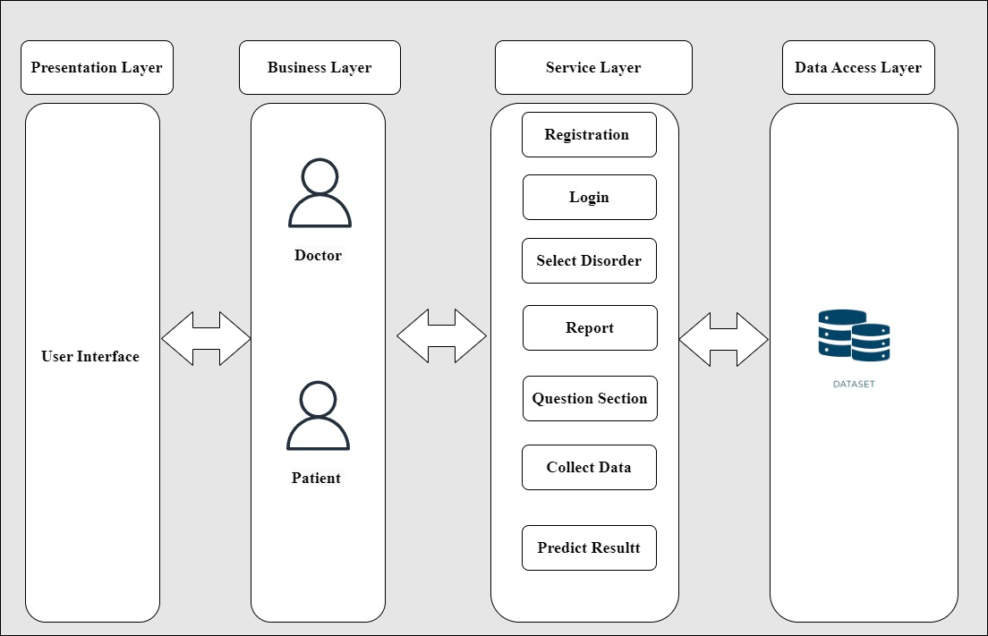
Architecture Diagram

Slide 37
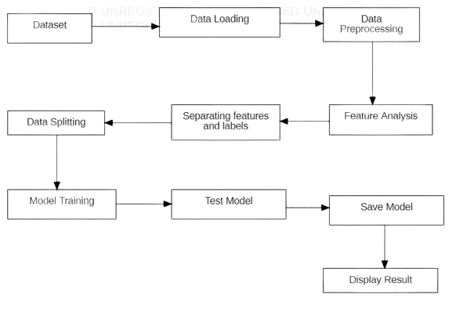
Process flow diagram

Slide 38
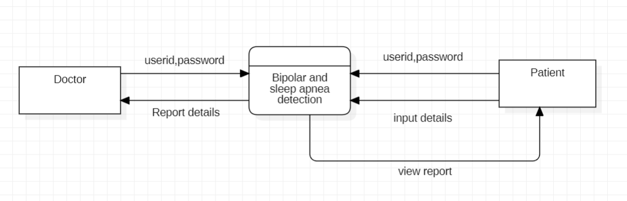
Context diagram

Slide 39
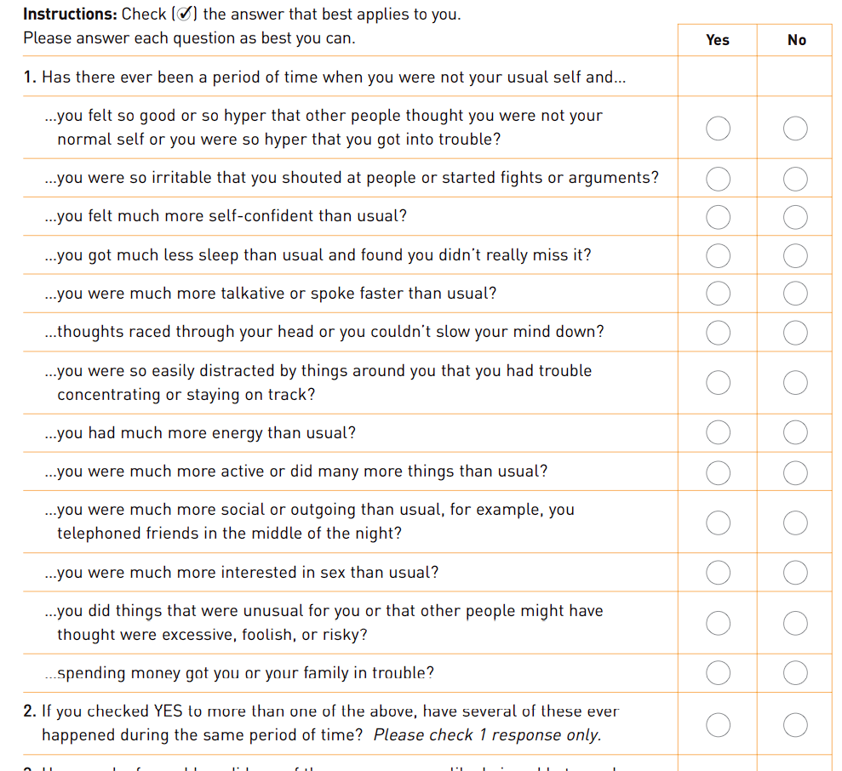
Questions

Slide 40
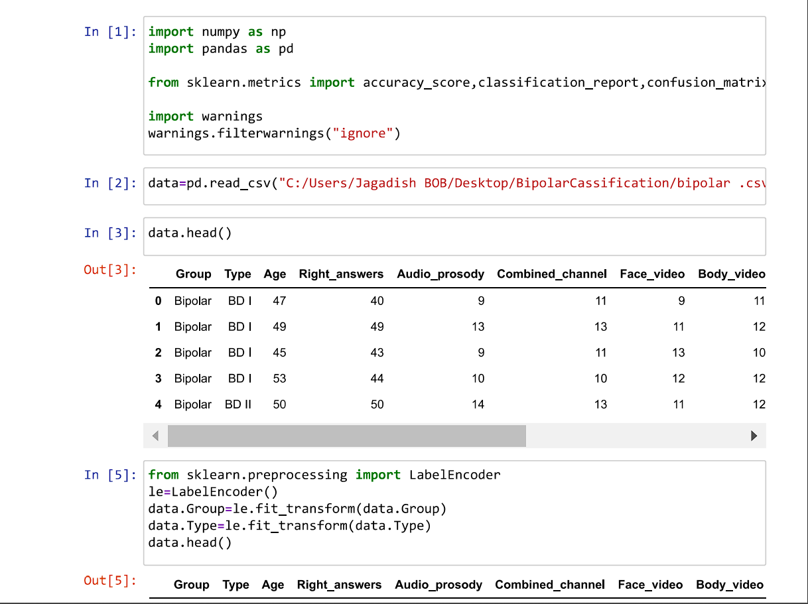
Screen shots

Slide 41
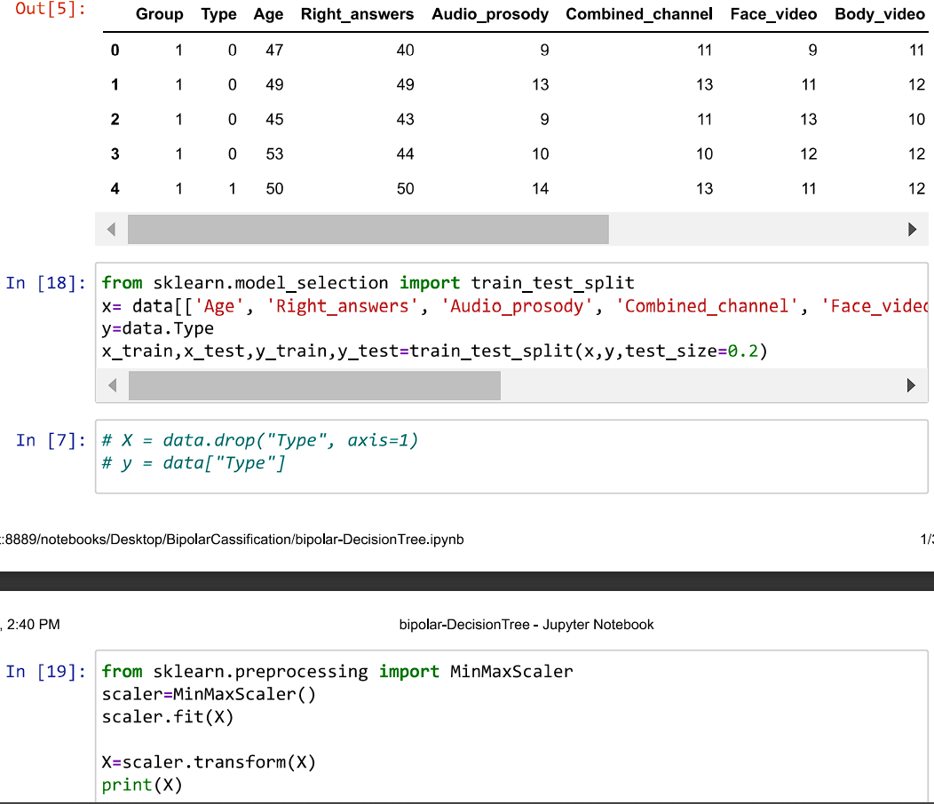

Slide 42
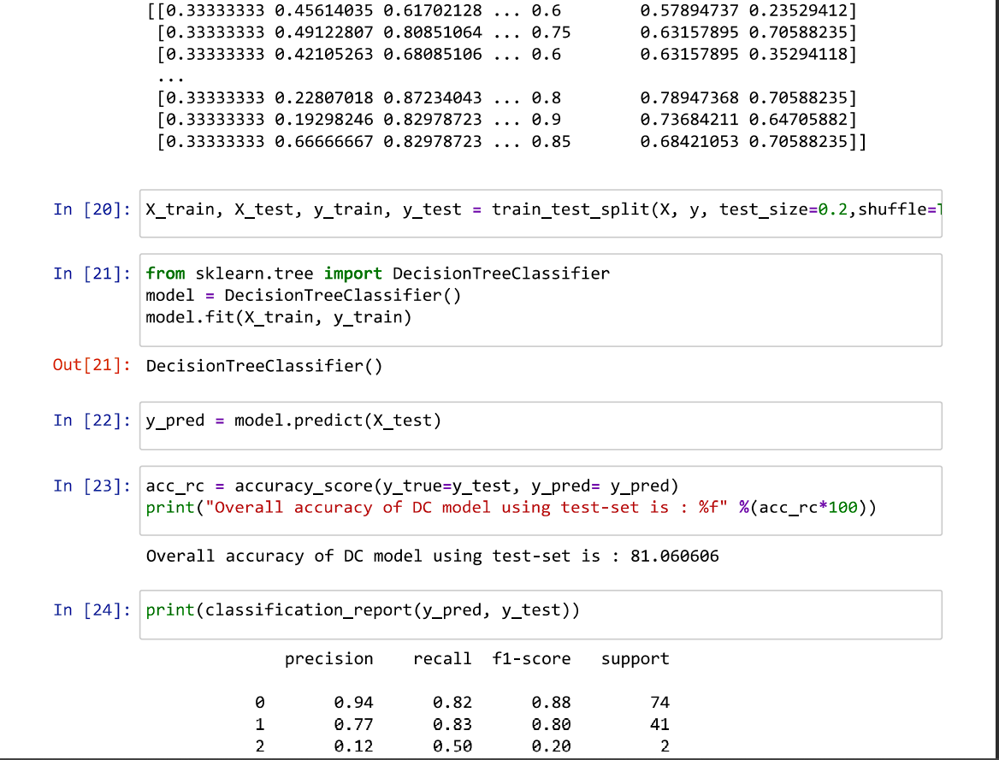

Slide 43
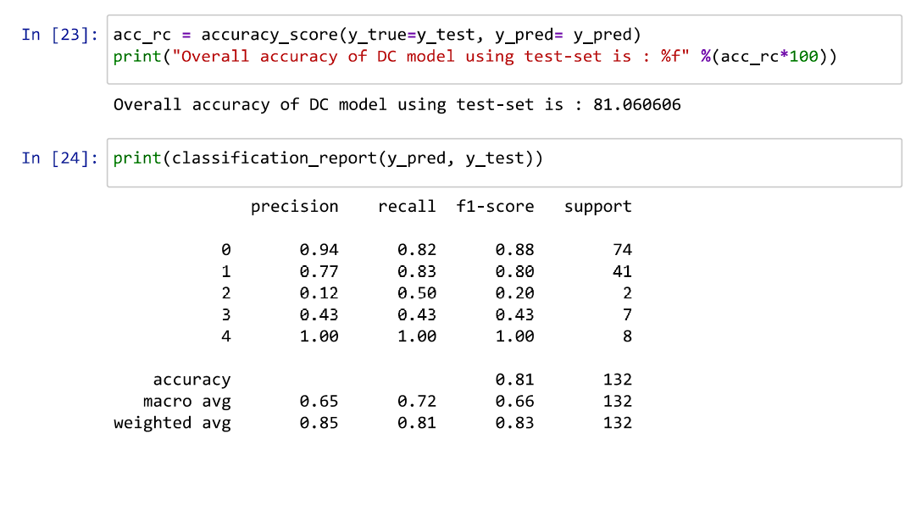

Slide 44
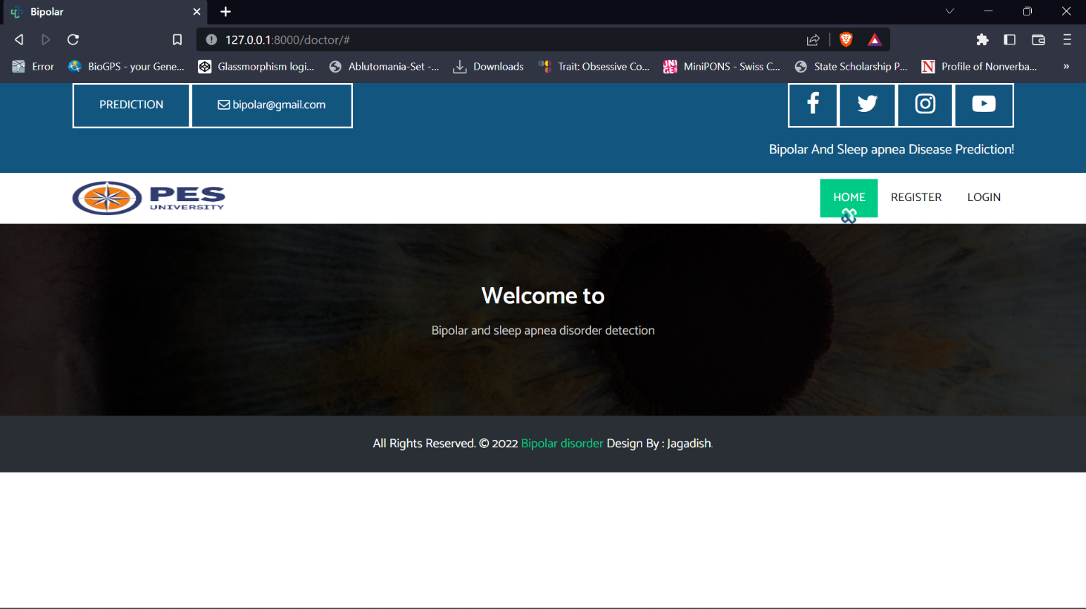

Slide 45
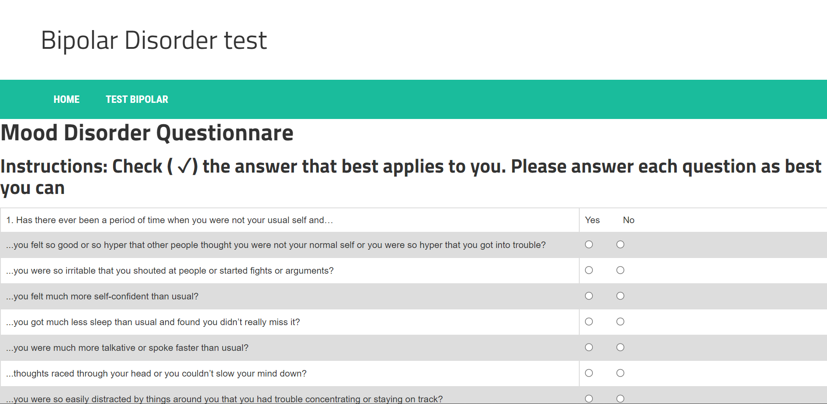

Slide 46
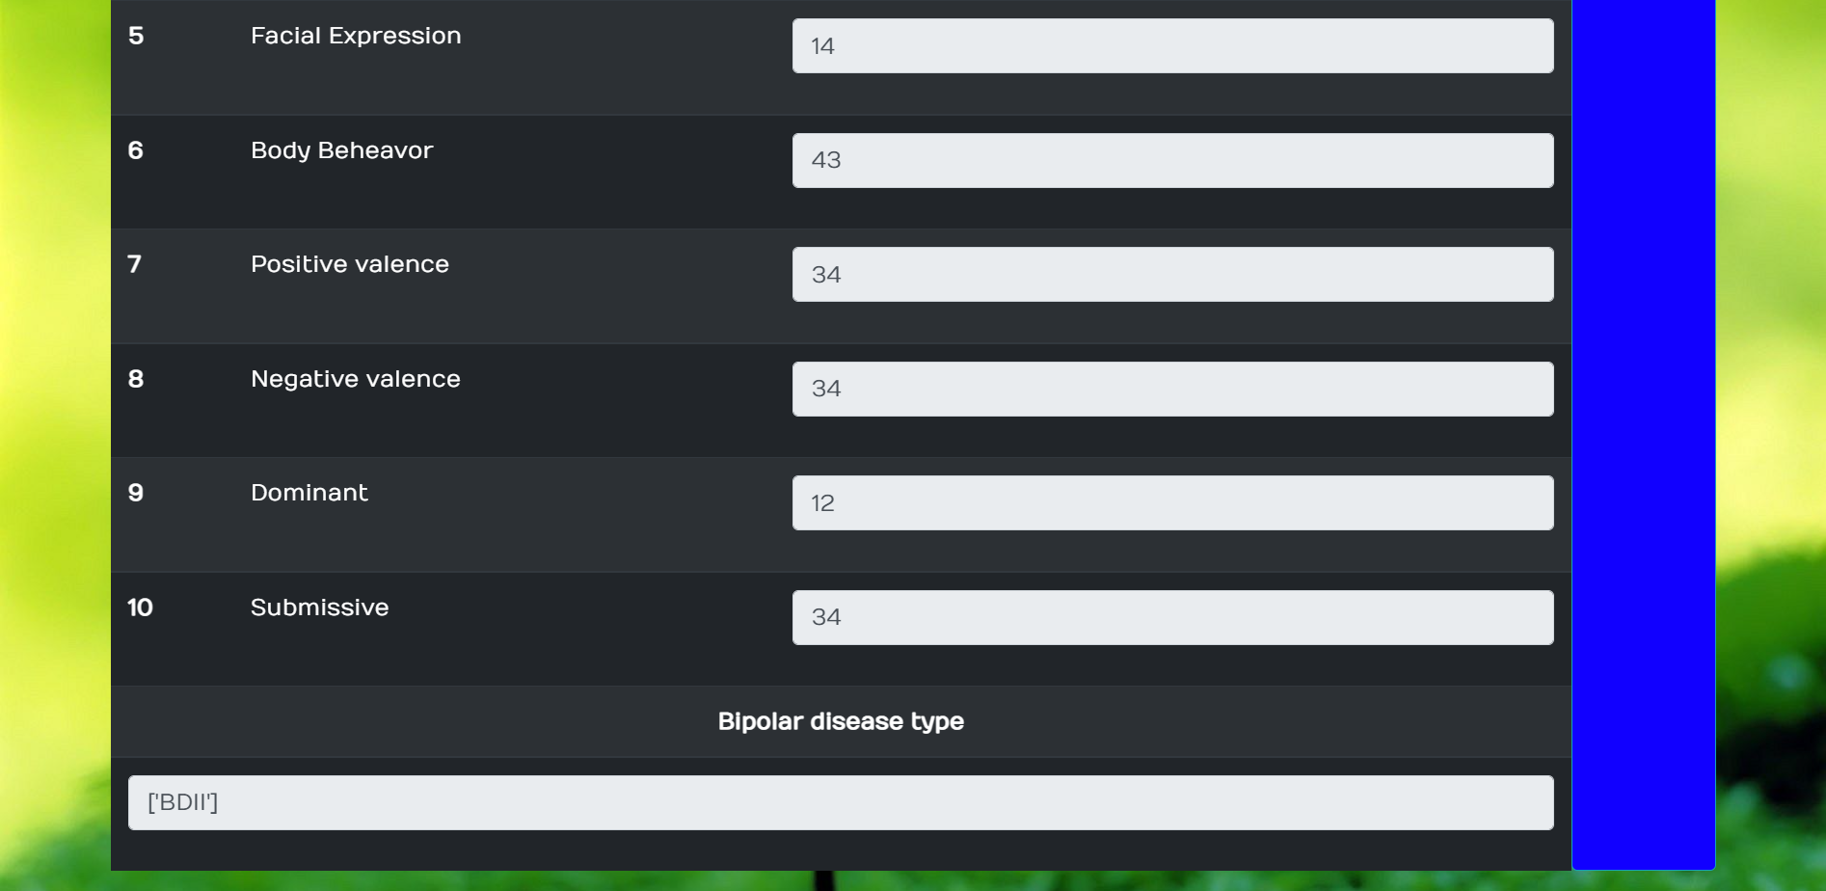

Slide 47
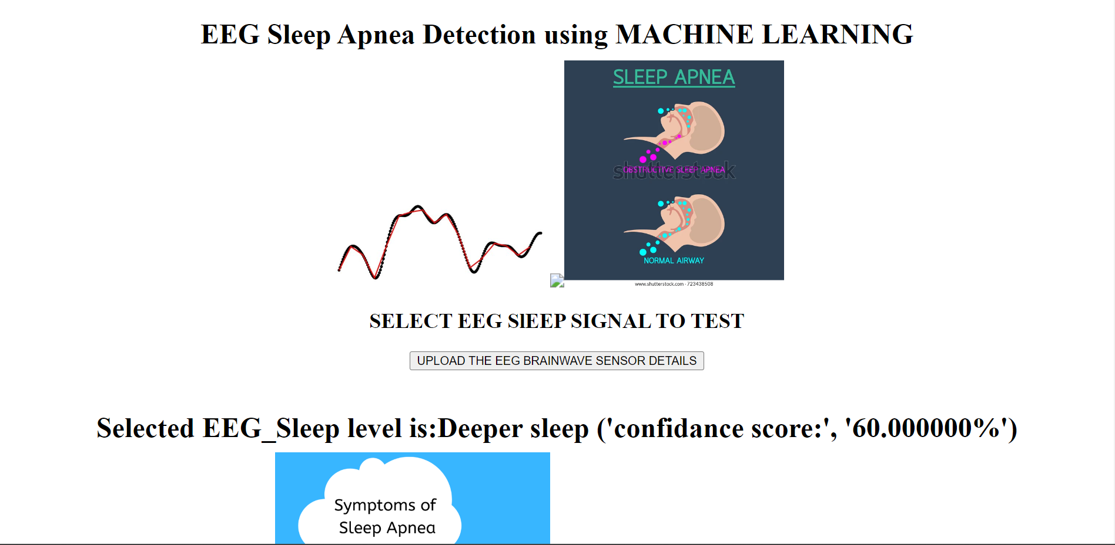

Slide 48
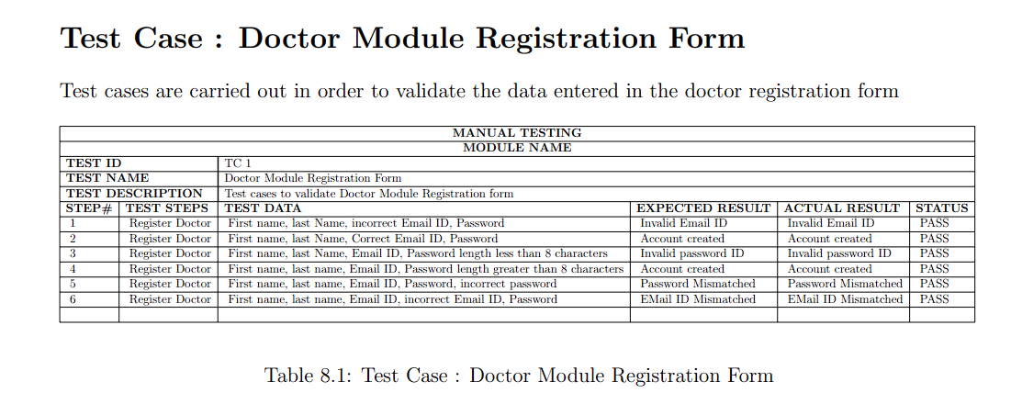
Testing

Slide 49
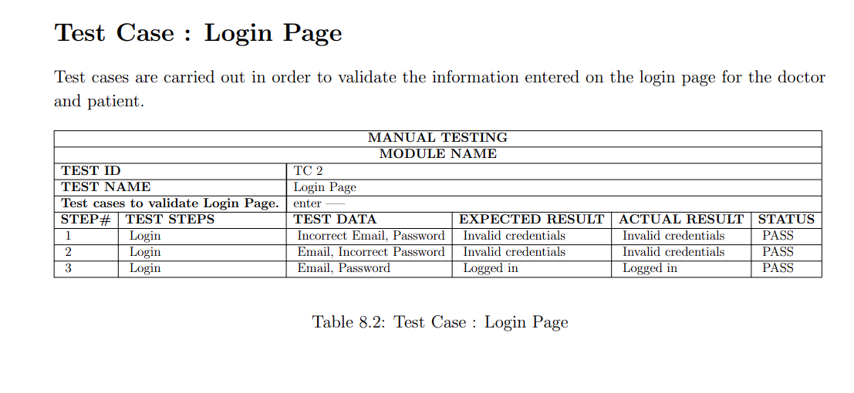

Slide 50
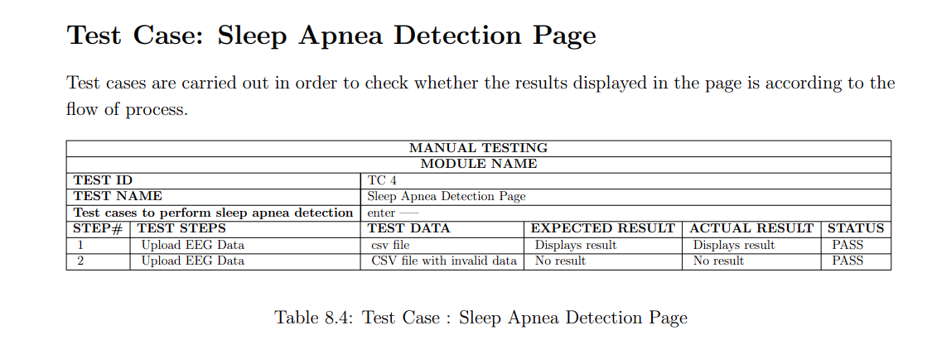

Slide 51
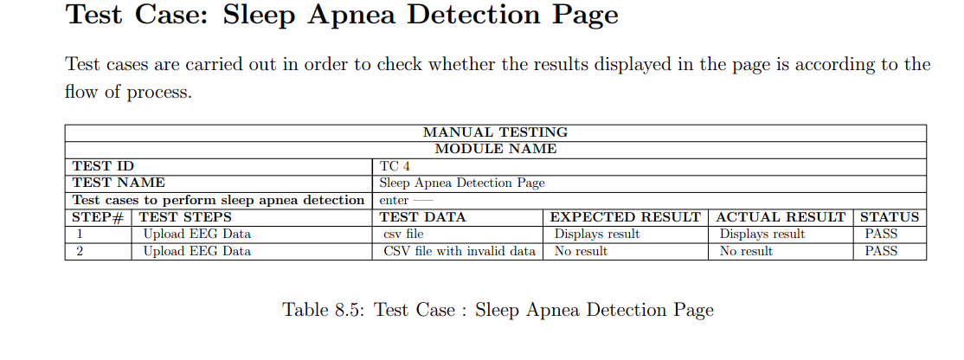

Slide 52
THANK YOU

